Slide 1
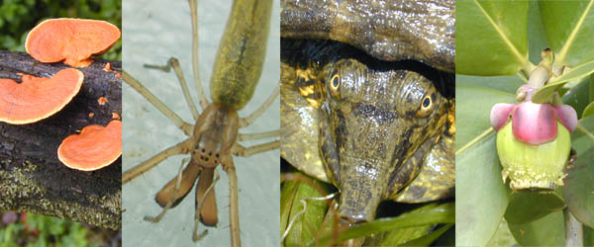
GENERAL BIOLOGY fdn 1203
Dr. Theja Abayarathna
Department of Biology
Faculty of Applied Sciences
Rajarata University of Sri Lanka

Slide 2
Communities and Ecosystems

Slide 3
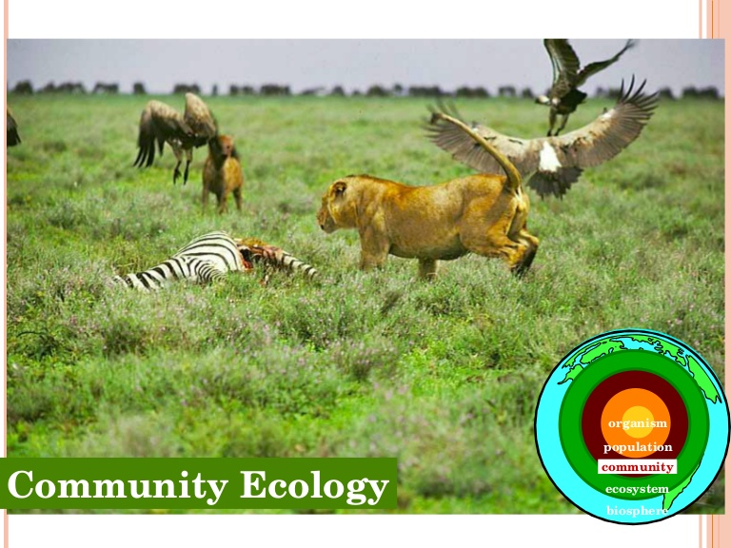
What is “Community” ?
All the organisms that live together in a place is called a community.

Slide 4
What is “Co-evolution”
The plants, animals, protists, fungi bacteria ect. live together and have changed and adjusted to one another continually over a period of millions of years.
Such interactions are called coevolution

Slide 5
Symbiotic relationships
Are shown by two or more kinds of organisms live in a place in permanent relationships.
Kinds of symbiosis
commensalisms
Mutualism
Parasitism

Slide 6
Commensalism
This relationship gives benefits for one species and neither hurts nor helps the other.
Individuals of one species is physically attached to members of another.
Ex. Epiphytes – They are the plants that grow on the branches of other plants.
Host plant is unharmed and the epiphyte benefits by having the substrate for growing.

Slide 7
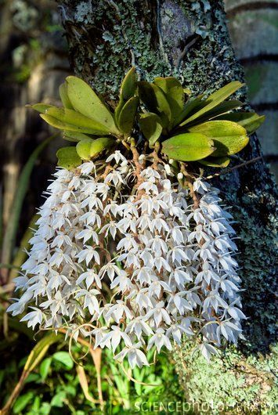
Orchid

Slide 8
Mutualism
In this relationship both species benefits.
Ex. Ants and aphids
Aphids are small insects that suck fluids from the phloem of living plants with their piercing mouth parts.

Slide 9
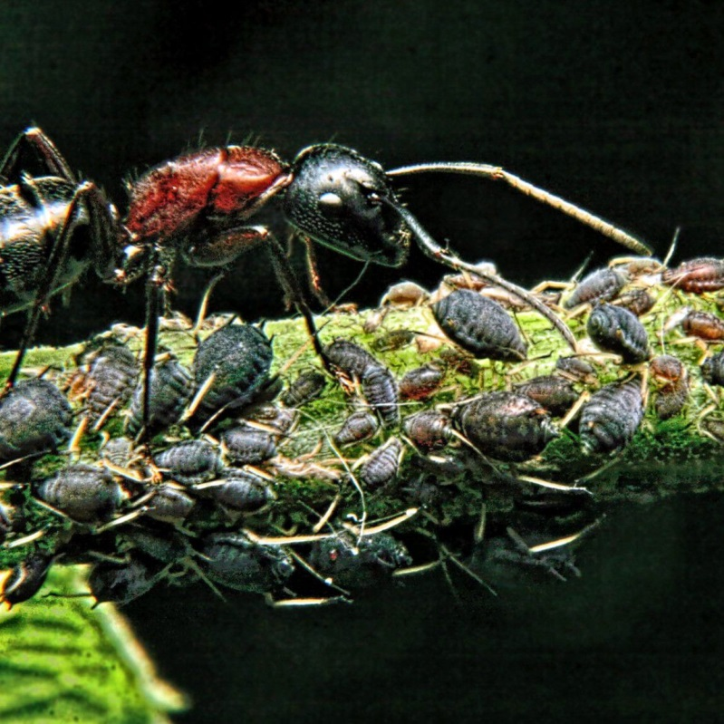
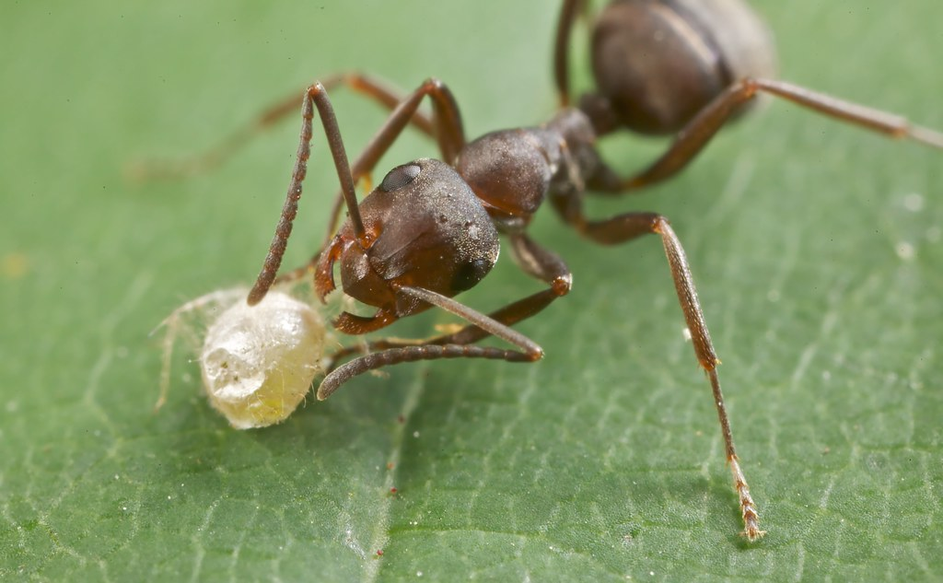
They excrete them through their anus.
Ants carry the aphids to new plants and then consume the excreted materials of aphids as food.
So, Aphids get new plants and ants get food

Slide 10
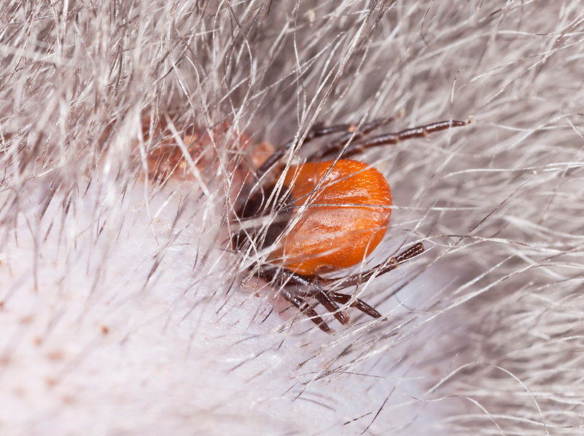
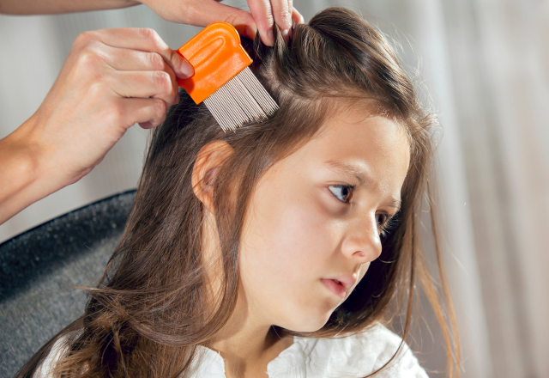
Parasitism
The parasite is much smaller than the prey that closely associated with it.
This relationship is harmful to the prey organism and beneficial to the parasite.
Ex. Lice
mites

Slide 11
Thank you!

